Slide 1

Technical Writing
Email etiquette & Email writing
Semester 3 – Professional Communication Skills (303193203)

Slide 2
Learning Objectives
Understand the structure and components of a professional email.
Identify key etiquettes for effective email communication.
Practice writing different types of formal and informal emails.
Develop clarity, tone, and precision in email writing.
Enhance digital professionalism through email.
Apply email writing skills in academic and workplace scenarios.

Slide 3
Introduction
Importance of written communication in the digital era:Clear written communication builds credibility and ensures effective information sharing across platforms.
Why email writing skills are essential for engineers?
Engineers frequently use emails to convey technical information, coordinate tasks, and maintain professionalism.
Role of proper etiquette in professional communication:
Proper etiquette fosters respect, minimizes misunderstandings, and reflects your professional identity.

Slide 4
Understanding Email Communication
Brief history and evolution:Email began in the 1970s and has evolved into a primary mode of formal digital communication.
Importance of emails in academic and professional contexts:Essential for submitting assignments, communicating with faculty, job applications, and workplace collaboration.
Email vs. other communication channels:More formal and traceable than chats or calls; suitable for detailed, documented interactions.

Slide 5
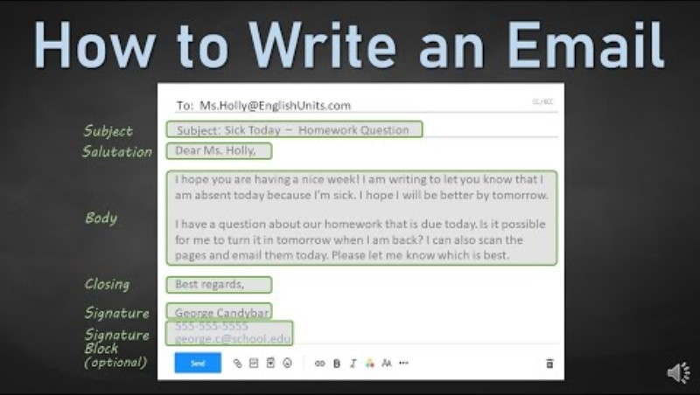
Structure of a Professional Email
Subject Line
Salutation
Opening Line
Body (Divided into logical paragraphs)
Closing Line
Sign-off
Signature Block

Slide 6
Components Explained with Example
Subject: Request for Project Extension – Submission Deadline
Salutation:
Dear Professor Sharma,
Opening Line:
I hope this message finds you well.
Body:
I am writing to request an extension on the submission deadline for our final-year project due on September 10th. Due to an unexpected personal emergency, I was unable to complete the remaining sections on time.
I assure you that the remaining work will be completed by September 15th. I kindly request you to consider granting this extension.

Slide 7
Components Explained with Example
I kindly request you to consider granting this extension.
Closing Line:
Thank you for your understanding and support.
Sign-off:
Sincerely,
Signature Block:
Rahul Patel
Final Year – B.Tech (Computer Engineering)
Roll No: 21CE123
Parul University

Slide 8
Email Etiquette Guidelines
Use a professional tone and appropriate language.
Avoid ALL CAPS and emoticons in professional emails.
Use concise subject lines.
Proofread for grammar and spelling errors.
Respond promptly.
Avoid unnecessary CC/BCC.

Slide 9
Effective Email Writing – Do’s
Do’s:
Be polite and respectful
Always use courteous language and maintain a professional tone.
Keep it concise
Avoid unnecessary details; stick to the main point.
Use paragraphs and bullet points
They help organize your message and improve readability.
Add a proper signature block
Include your full name, course, and contact information.

Slide 10
Effective Email Writing – Don’ts
Don’ts:
Use informal slang
It reduces the professionalism and clarity of your message.
Forward unrelated threads
This can confuse the recipient and clutter communication.
Ignore follow-ups
It shows a lack of responsibility and may affect your credibility.
Use vague subject lines
Always be specific to help the reader understand the purpose instantly.

Slide 11
Sample Formal Email
Introducing a Team Member
Subject: Introduction of New Team Member – [Team Member’s Name]
Dear Team,
I am pleased to introduce [Team Member’s Full Name], who has recently joined our team as [Position/Role]. [He/She/They] bring(s) extensive experience in [brief relevant expertise] and will be assisting us with [specific responsibilities or projects].
Please join me in welcoming [Team Member’s Name] and feel free to reach out to [him/her/them] for any related support or collaboration.
Regards,
[Your Full Name]

Slide 12
Sample Formal Email
Complaint and Inquiry Email
Subject: Complaint and Request for Update on [Issue]
Dear [Recipient’s Name],
I am concerned about [brief description of the issue]. Despite earlier messages, the issue is still unresolved and causing problems.
Please update me on the status and your company’s policy for such complaints.
Thank you for your quick response.
Sincerely,
[Your Name]
[Your Contact Information]

Slide 13
Common Mistakes to Avoid
Typing errors
They create a negative impression and can alter the message’s meaning.
Incomplete information
It leads to confusion and unnecessary back-and-forth communication.
Lack of greeting or closing
This makes the email seem abrupt or impolite.
Overuse of jargon
It may confuse readers who are unfamiliar with technical terms.

Slide 14
Activity 1 -Identify the Errors
Instructions:
identify and correct the mistakes
Subject: IMPORTANT!!!! Read this NOW
hey students,
i hope you all doing good. i wanted to tell you that the assignment is due next week so pls make sure to send it on time. if you have any questions dont hesitate to ask me anytime. also dont forget to submit the report in PDF or word doc format.
thx
mr. macwan

Slide 15
Activity 2 -Draft an Email
Task:
Draft an email seeking internship opportunities in a company
Include: Subject, Salutation, Body, Closing, and Signature
Peer Review: Exchange with a partner for feedback

Slide 16
Activity 2 -Draft an Email
Task:
Draft an email seeking internship opportunities in a company
Include: Subject, Salutation, Body, Closing, and Signature
Peer Review: Exchange with a partner for feedback

Slide 17
Conclusion
Recap of key points:
• Email writing is a vital skill for engineers
• Proper etiquette creates a lasting impression
• Practice and feedback lead to better communication

Slide 18
Learning Outcomes
By the end of this two-hour session, students will be able to:
• Understand and apply the components of a formal email
• Follow standard email etiquette in academic and professional settings
• Draft clear, concise, and polite email messages
• Recognize and avoid common email writing mistakes

Slide 19
Thank You

